Slide 1



ROBERTO FREATO
AZURE APP SERVICE DEEP DIVE
Тема доклада
Тема доклада
Тема доклада
.NET CONFERENCE #1 IN UKRAINE
KYIV 2019

Slide 2




Scalable architectures for Web
01 Worker
Executes the application code
02 Deployer
Someone who deploys the code
05 State/File server
Where outplace the state of workers
04 Load balancer
03 Worker (2)
To split/balance the traffic between the instances
Another worker placed

Slide 3
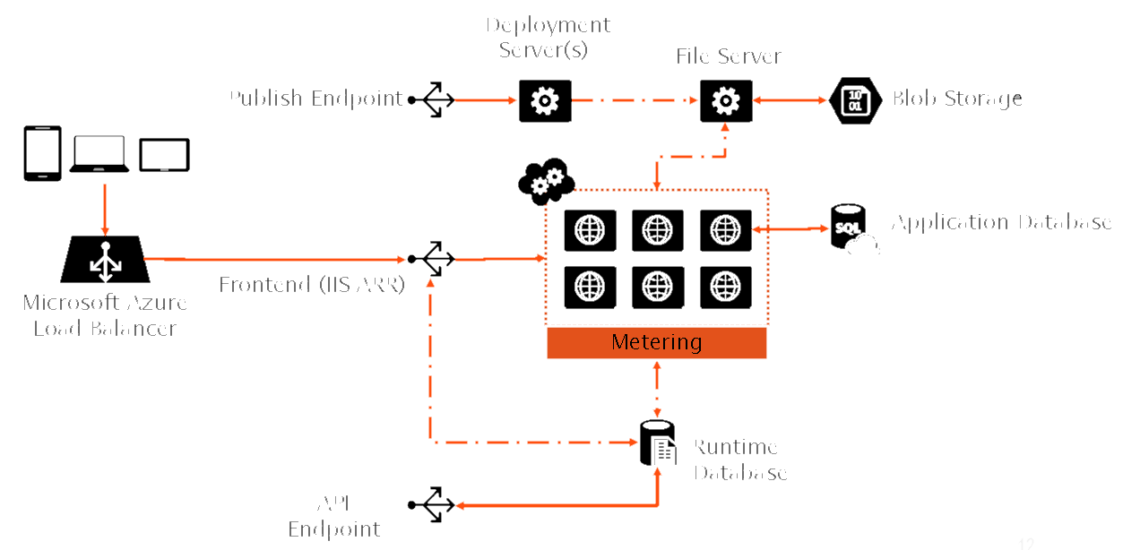
This is App Service
Notes:
BG replacement

Slide 4
demo
Topology highlights: plans, tiers, scaling

Slide 5
Deployment options
Direct
FTP
WebDeploy
Indirect (Manual)
OneDrive
Dropbox
Indirect (CI)
Local Git
Pipelines
GitHub
Bitbucket
Slots
Configuration

Slide 6
demo
Deployments options with Azure App Service

Slide 7
Inbound Security
Client certificates
Declarative Authentication with external IdPs
SSL Only (and Custom certificates)

Slide 8
demo
Security options with Azure App Service

Slide 9
Governance
Automated Backups
Isolated Console access
Resources Monitoring
App Service Editor
Automation and Resources Portal
Real-time logging

Slide 10
demo
Governance options with Azure App Service

Slide 11
Background code
Containers
WebJobs
Linux
Windows
Continuous
Triggered

Slide 12
demo
Background jobs with App Service WebJobs

Slide 13
Kudu Technology
Open-source
Great features
https://github.com/projectkudu/kudu
VFS REST API
Isolated
Engine behind App Service
Webhooks

Slide 14
demo
Inside Kudu with VFS API and Webhooks

Slide 15
Linux options
Containerized application
Basic application

Slide 16
demo
Linux options with Azure App Service

Slide 17
(some) Advanced scenarios
Hybrid Connections
Extensions
App Service Environment

Slide 18
demo
Extensions and Hybrid Connections

Slide 19
ROBERTO FREATO
AZURE APP SERVICE DEEP DIVE
Тема доклада
Тема доклада
Тема доклада
.NET CONFERENCE #1 IN UKRAINE
KYIV 2019

